Slide 1



EVChargeIQ
Review-3
Team Members
B. Gnaneshwari-2420030781
M. Rithika Reddy-2420030683
S. Alekhya-2420030603
Course Instructor: Dr. Shirisha
A Scalable Data Engineering Platform for EV Charging Demand Forecasting and Station Optimization

Slide 2
Methodology
1. Data Acquisition & Schema Validation
  Input: EV charging records + historical station records
  Tool: Python
  Operations:
  Load source records using Python data-processing libraries.
  Parse CSV / JSON / API response records into structured tabular data.
  Validate required fields such as:
  station_id
  timestamp
  charging_sessions
  energy_consumed
  charging_duration
  station_capacity
  Perform schema validation and data-type validation.
  Convert timestamps into a consistent datetime format.
  Standardize station identifiers before downstream processing.
  Output: Raw structured EV charging dataset

Slide 3
Methodology
2. Data Preprocessing & Feature Engineering
  Input: Raw structured EV charging dataset
  Tool: Python
  Operations:
  Detect and handle missing values in charging records.
  Remove duplicate and inconsistent records.
  Identify invalid values in energy_consumed, charging_duration, and station_capacity.
  Perform data-type conversion for numerical and categorical attributes.
  Extract temporal features from timestamp such as:
  hour
  day
  weekday
  month
  Calculate station-level charging demand from charging sessions and energy consumption.
  Generate relevant features required for downstream demand forecasting.
  Output: Cleaned and feature-engineered EV charging dataset

Slide 4
Methodology
3. Real-Time Data Ingestion
  Input: Processed EV charging records
  Tool: Apache Kafka
  Operations:
  Configure Kafka producers to publish incoming charging records.
  Serialize charging records into structured message format.
  Create Kafka topics for EV charging data streams.
  Stream charging events continuously through Kafka.
  Configure consumers to receive data for downstream processing.
  Output: Real-time EV charging data stream

Slide 5
Methodology
4. Distributed Data Processing
  Input: Kafka EV charging data stream
  Tool: Apache Spark
  Operations:
  Consume streaming records from Kafka.
  Deserialize and validate incoming records.
  Apply distributed data transformations.
  Perform station-wise and time-based aggregations.
  Calculate charging demand and station utilization metrics.
  Generate processed features for forecasting.
  Output: Processed and aggregated EV demand dataset

Slide 6
Methodology
  5. Data Storage
  Input: Processed EV demand dataset
  Tool: PostgreSQL
  Operations:
  Define relational tables for charging stations and charging records.
  Store processed and historical charging data.
  Maintain station-wise demand and utilization records.
  Execute SQL queries for data retrieval and aggregation.
  Provide historical datasets for machine-learning model training.
  Output: Structured EV charging database

Slide 7
Methodology
  6. Workflow Automation
  Input: Data ingestion, processing, storage and forecasting tasks
  Tool: Apache Airflow
  Operations:
  Create an Airflow DAG for the complete data pipeline.
  Define task dependencies between pipeline stages.
  Schedule periodic data ingestion and processing.
  Automate data transformation and database updates.
  Monitor task execution and pipeline status.
  Output: Automated EV data-processing pipeline

Slide 8
Methodology
  7. EV Demand Forecasting
  Input: Historical processed EV charging data
  Tool: Scikit-learn
  Operations:
  Select relevant temporal and station-related features.
  Split the dataset into training and testing sets.
  Train a machine-learning forecasting model.
  Predict future charging demand for individual stations.
  Evaluate forecasting performance using suitable evaluation metrics.
  Output: Predicted EV charging demand

Slide 9
Methodology
  8. Charging Station Optimization
  Input: Predicted demand + station capacity
  Tool: Python
  Operations:
  Compare predicted charging demand with station capacity.
  Calculate station utilization levels.
  Identify congestion-prone charging stations.
  Identify underutilized charging stations.
  Generate resource-allocation insights based on predicted demand.
  Output: Charging-station utilization and optimization results

Slide 10
Methodology
  9. Visualization
  Input: Forecasted demand + station utilization results
  Tool: Power BI / Tableau
  Operations:
  Import processed and forecasted datasets.
  Generate station-wise demand visualizations.
  Compare historical and predicted charging demand.
  Visualize station utilization and congestion levels.
  Develop interactive dashboards for infrastructure planning.
  Output: EV demand forecasting and optimization dashboard

Slide 11

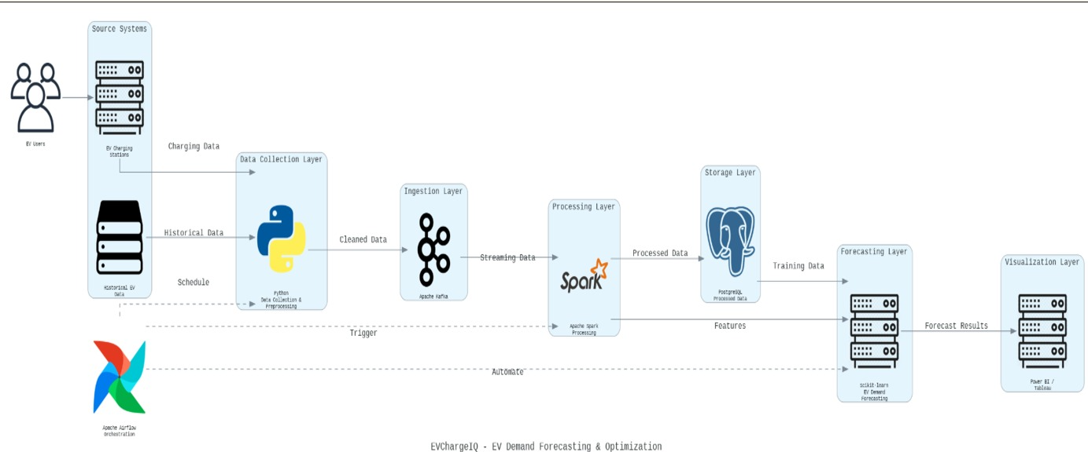
System Architechture

Slide 12


Use of Modern Tools & Technologies
Collects EV charging data from available sources.
Cleans and preprocesses the collected data.
Ingests data reliably using Apache Kafka.
Processes large-scale data using Apache Spark.
Stores processed data in PostgreSQL.
Forecasts future EV charging demand using Machine Learning.
Identifies congestion-prone and underutilized charging stations.
Visualizes forecasts and station insights through dashboards.

Slide 13
Coding Quality
  Modular
Separate stages for ingestion, processing, storage and forecasting.
  Scalable
Kafka and Spark support processing of large charging datasets.
  Automated
Airflow coordinates pipeline execution.
  Maintainable
Each stage has a defined responsibility.

Slide 14
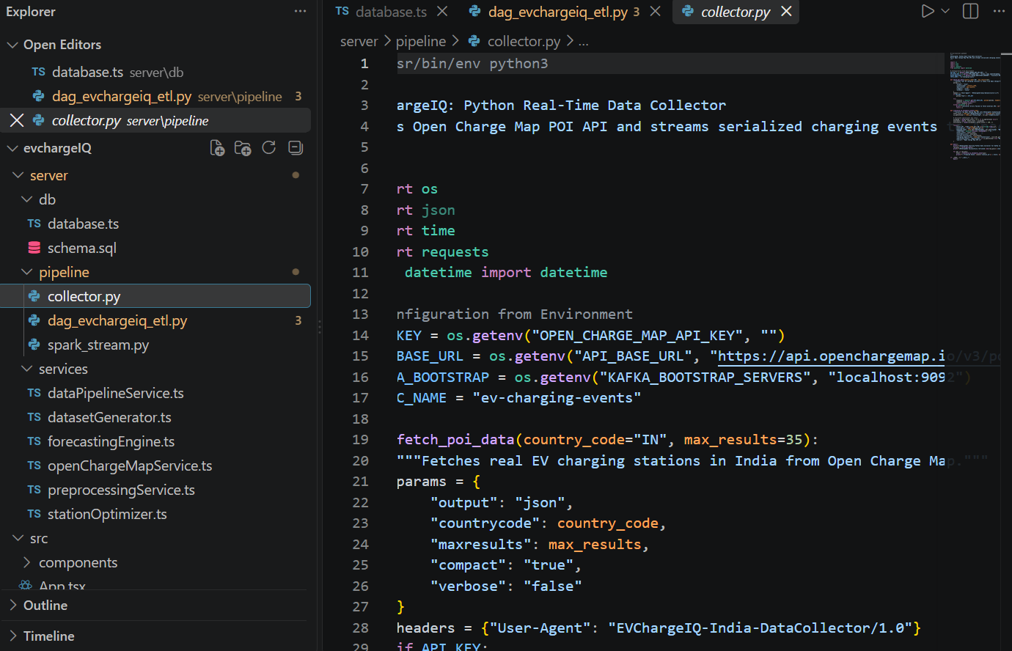
Implementation

Slide 15
Thank You

